Slide 1
Chapter 2 Containerization with Docker

Slide 2
Learning Topics
Overview of Docker
Container & Images
Portainer – Docker UI
Dockerfile
Docker Hub
Dockerize a .Net App
Docker Best Practices

Slide 3
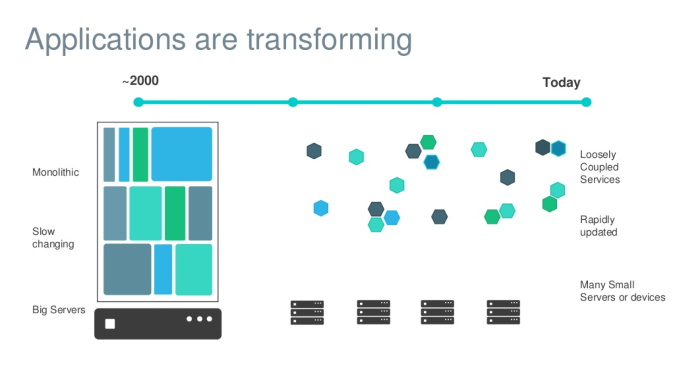
Evolving Workloads

Slide 4
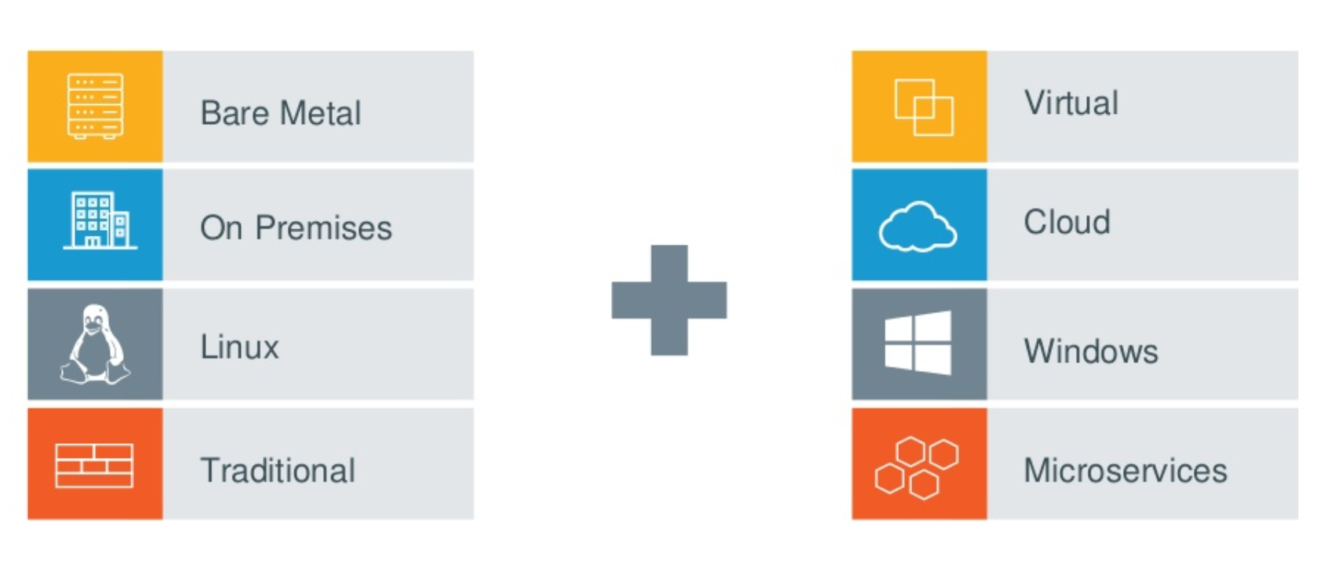
Multiple Requirements to Fill

Slide 5
What is Docker?
Docker is an open platform for developers and sysadmins to build, ship, and run distributed applications, whether on laptops, data centre VMs, or the cloud.
Docker is a technology to package an application and all its dependencies into a single, easily transportable container
Fixes the traditional “But it works on my machine” problem

Slide 6
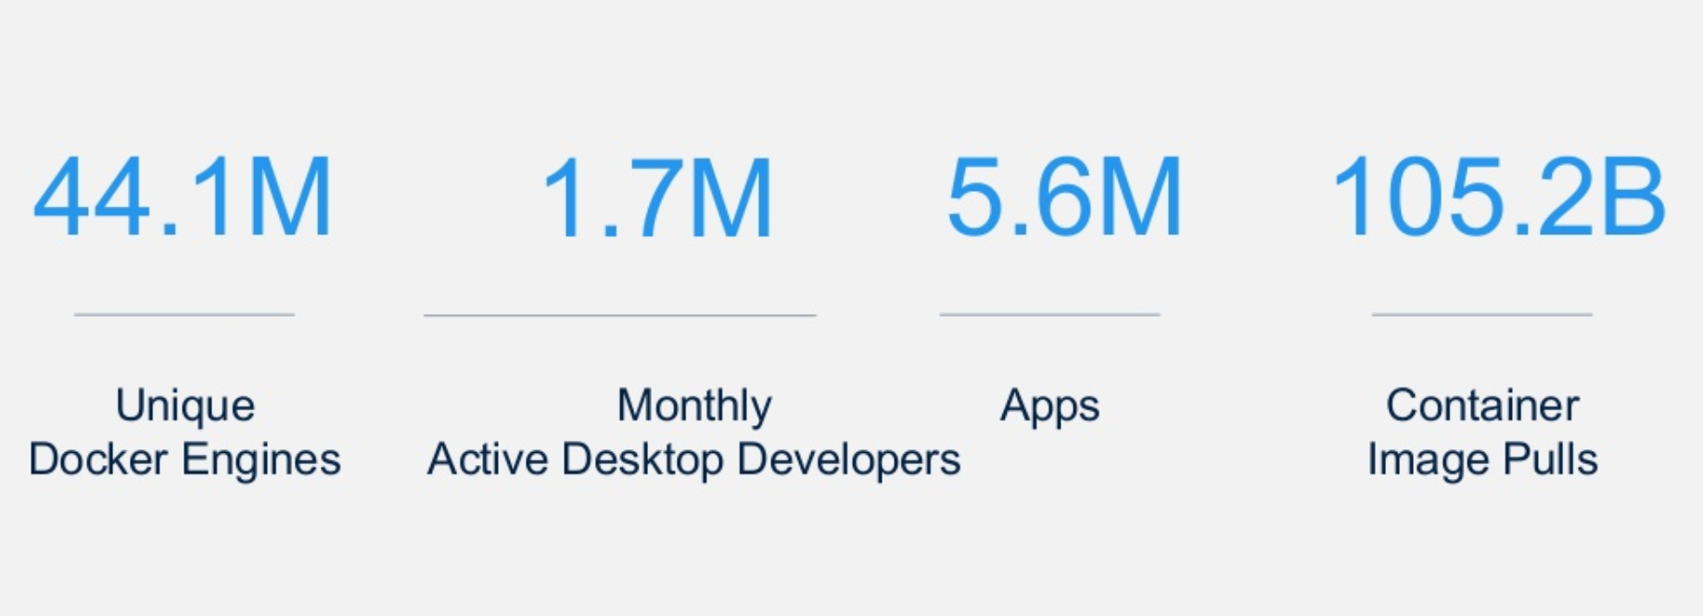
Docker by the Numbers

Slide 7
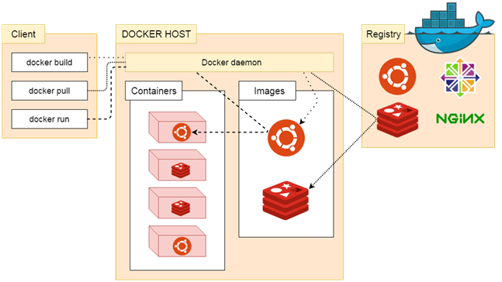
Docker Architecture
Docker uses a client-server architecture.
The Docker client talks to the Docker daemon, which does the heavy lifting of building, running, and distributing your Docker containers.
The Docker client and daemon can run on the same system, or you can connect a Docker client to a remote Docker daemon.
The Docker client and daemon communicate using a REST API, over UNIX sockets or a network interface.

Slide 8
Docker – Lab 1
Run “Hello World” Docker Container

Slide 9
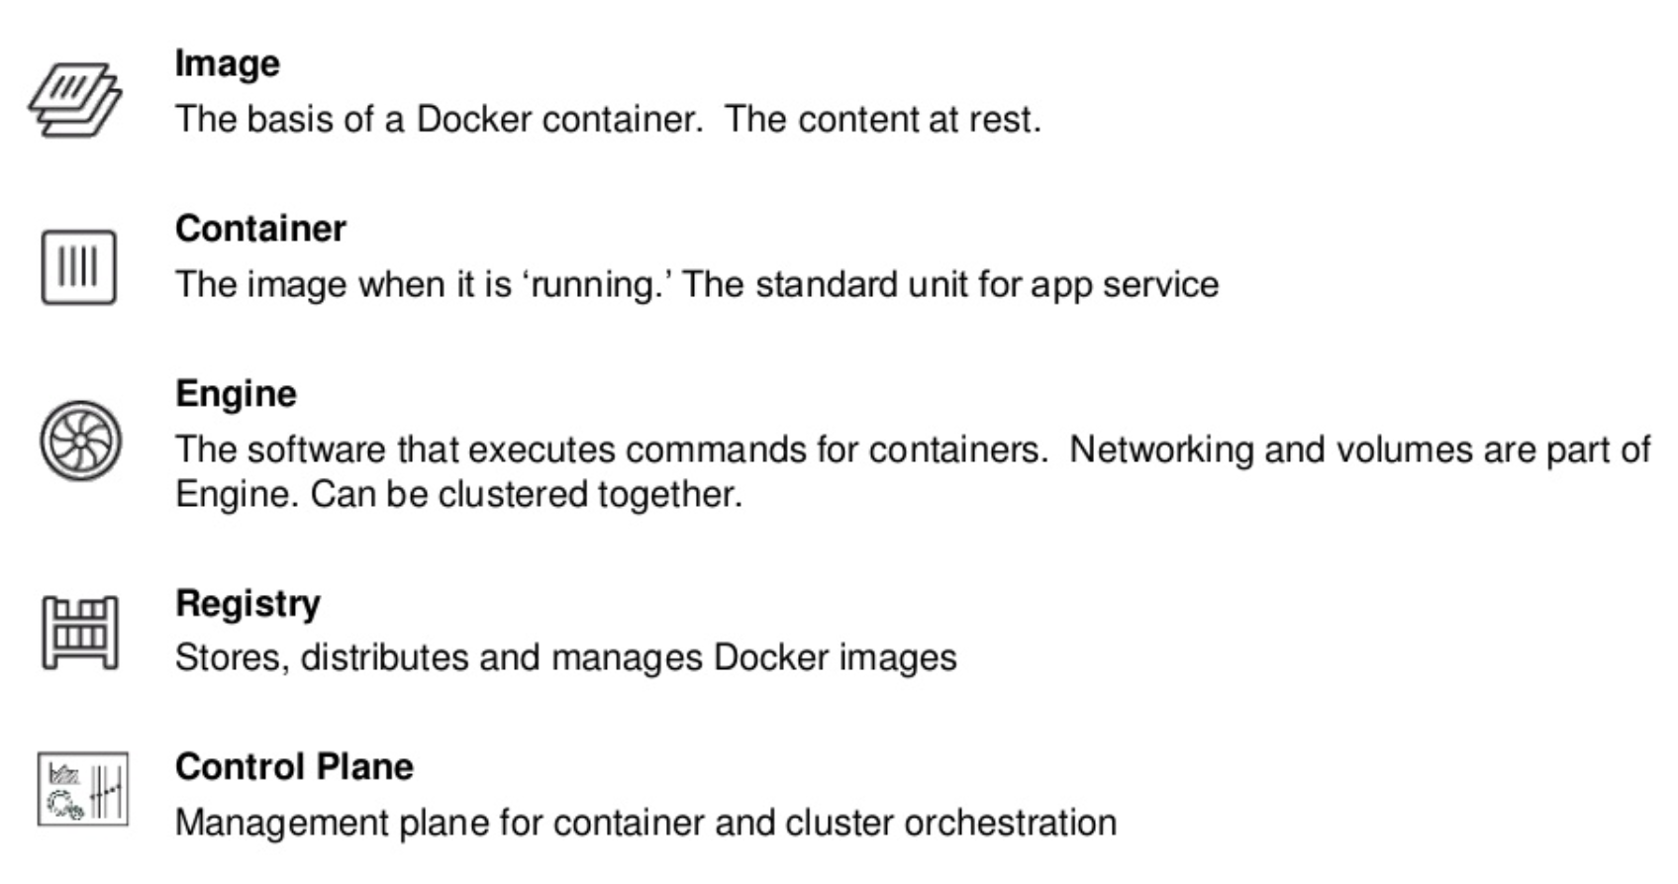
Docker Basics

Slide 10
Images
In Docker, everything is based on Images
An image is a read-only template with instructions for creating a Docker container
Usually an image is based on another image, with some additional customization.
For example, you may build an image which is based on the ubuntu image, but installs the Apache web server and your application, as well as the configuration details needed to make your application run.

Slide 11
Containers
The basic purpose of Docker is to run containers
A container is a runnable instance of an image
You can create, start, stop, move, or delete a container using the Docker API or CLI
When a container is removed, any changes to its state that are not stored in persistent storage disappear
A container is defined by its image as well as any configuration options you provide to it when you create or start it

Slide 12
Lab 2 – Run Container Using an Image
Run Container using “nginx” Image
View Output on Browser
Uses Port forwarding

Slide 13
Lab 3 – Portainer
UI for Managing Docker
Runs on 1 Container
Uses Persistent Storage (Volume)
Multi Tier Web Application

Slide 14
Dockerfile
A text document that contains all the commands, in order, a user could call on the command line to assemble an image
Build instructions to build the image
Usually dockerfile is called Dockerfile
Located in root of context
docker build -f /path/to/a/Dockerfile .

Slide 15
Dockerfile Instructions
A Dockerfile must start with a `FROM` instruction
The FROM instruction specifies the base image from which you are building
Docker treats lines that begin with # as a comment

Slide 16
Lab 4 – Create an Image Using Dockerfile
Uses Docker “Build” Command
Creates an Image
Nginx Web Application
Run Container using this Image

Slide 17
Docker Hub
Docker Hub is a cloud-based registry service
Docker users and partners create, test, store and distribute container images
Centralized resource for container image discovery, distribution and change management
User and team collaboration and workflow automation throughout the development pipeline.

Slide 18
Docker Hub - Features
Image Repositories - Lets you share images with co-workers, customers, or the Docker community at large
Organizations - Create work groups to manage access to image repositories
GitHub and Bitbucket Integration - Add the Hub and your Docker Images to your current workflows

Slide 19
Lab 5 – Save & Pull Image
Create a new repository in Docker Hub
Push Your Images in Docker Hub Repos
We will need these in K8 labs

Slide 20
Lab 6 – Dockerize .Net App
Write Dockerfile for a .Net & Angular app
Create Image
Run Container using this Image
Save Image in Docker Hub

Slide 21
Group Assignment
Update .Net Output (Change Text to Your Team Name on Browser Output)
Share Image on Docker Hub
Only One Image Per Group
Run Container Locally to Show Output

Slide 22
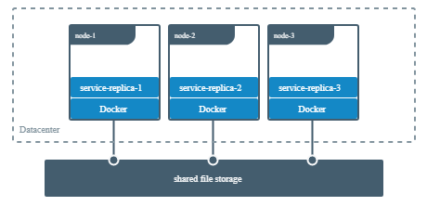
Docker Volumes
Volumes work on both Linux and Windows containers.
Volumes can be more safely shared among multiple containers.
Volume drivers let you store volumes on remote hosts or cloud providers, to encrypt the contents of volumes, or to add other functionality.
New volumes can have their content pre-populated by a container.
Volumes are completely managed by Docker

Slide 23
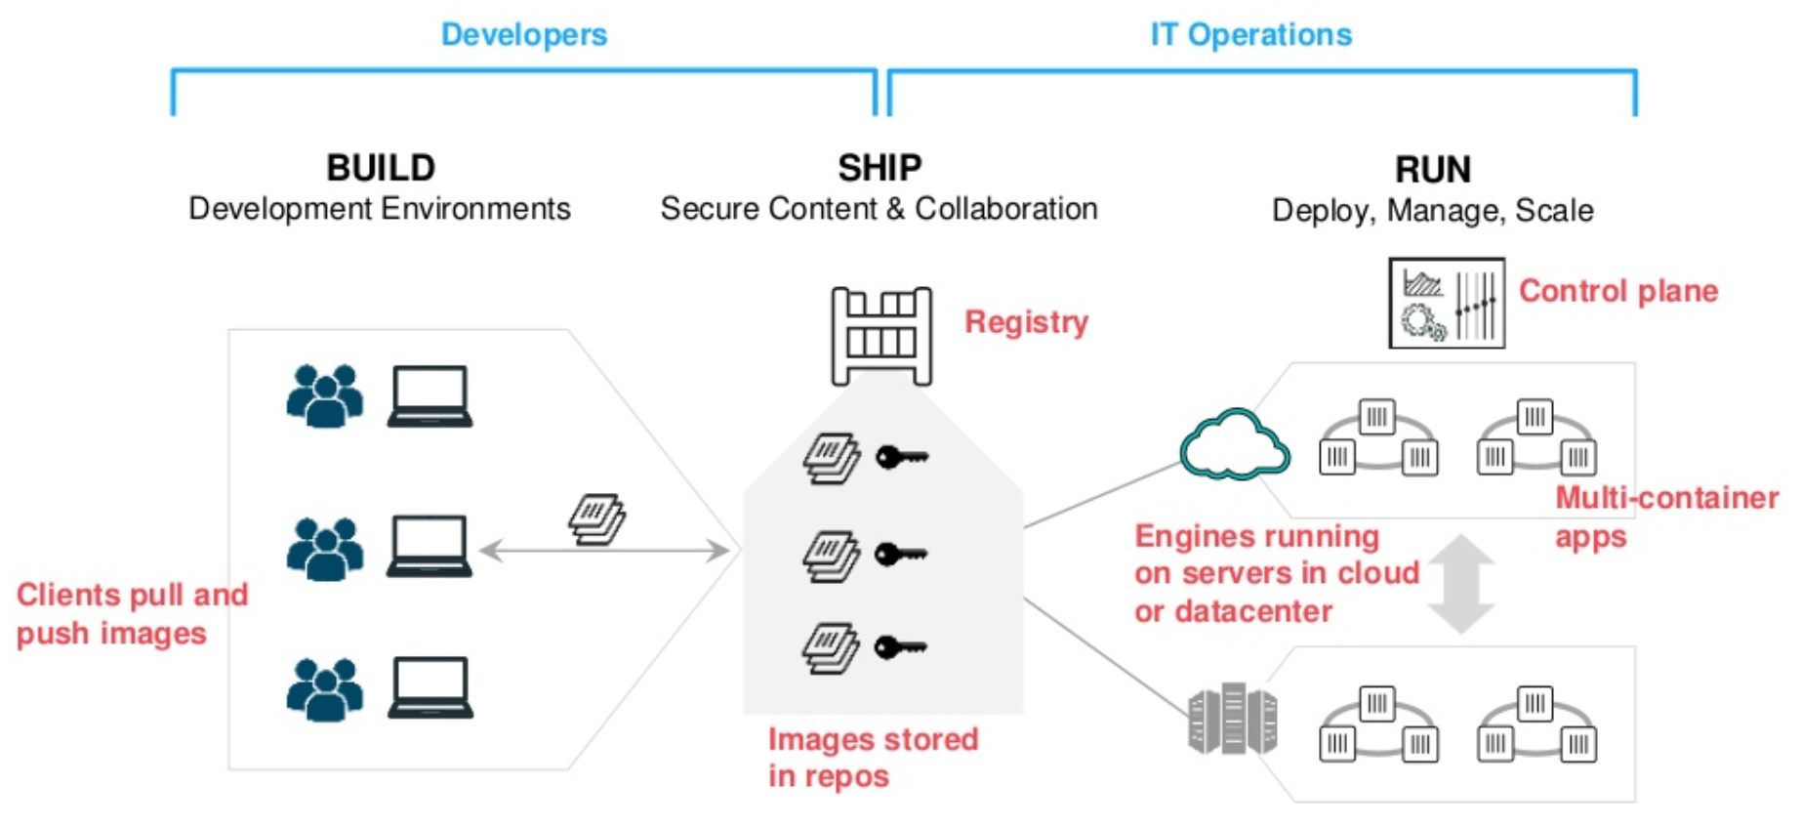
Containers as a Service

Slide 24
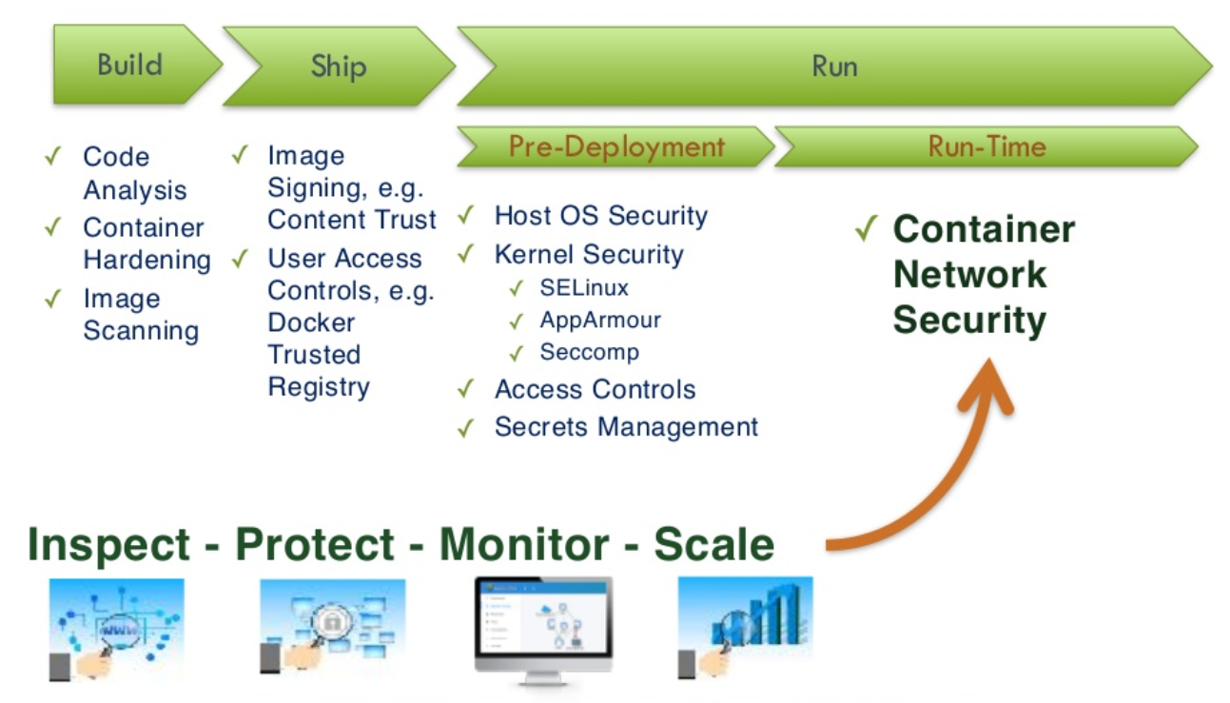
Containers Security

Slide 25
Docker Secrets
Use secrets to manage any sensitive data which a container needs at runtime
Docker secrets are only available to swarm services, not to standalone containers
Secrets are encrypted during transit and at rest in a Docker swarm
Use secrets to provide a layer of abstraction between the container and a set of credentials

Slide 26
Advantages of Docker
Consistency
Write once, deploy anywhere
A complete platform
Manage entire lifecycle
Base engine for containers
Registry for image management
Compose for orchestration
Swarm for clustering
Machine for provisioning

Slide 27
Use Cases of Docker
Distributed Applications
Microservices
Continuous Integration
Continuous Deployment
Setting up Development Environment
Build, Ship and Run Any App, Anywhere

Slide 28
Container Best Practices
Containers should be immutable
Containers should be ephemeral
Containers should be lightweight
One container, One responsibility, One process
Store share data in volumes, not in containers
Don’t store credentials in the image
Keep your images small
Use tags to reference specific versions of your images
Store data using volumes

Slide 29
This concludes Chapter 2 Containerization with Docker

